Slide 1


Slide 2


Slide 3
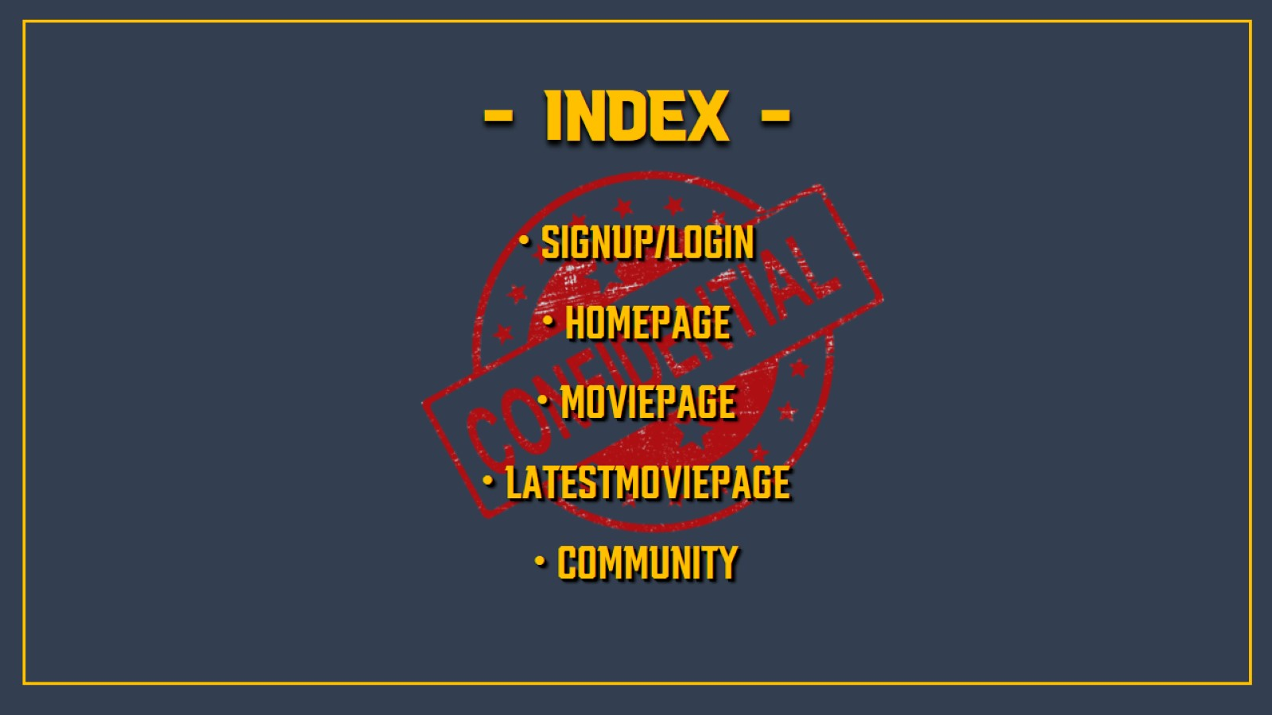
- INDEX -

Slide 4
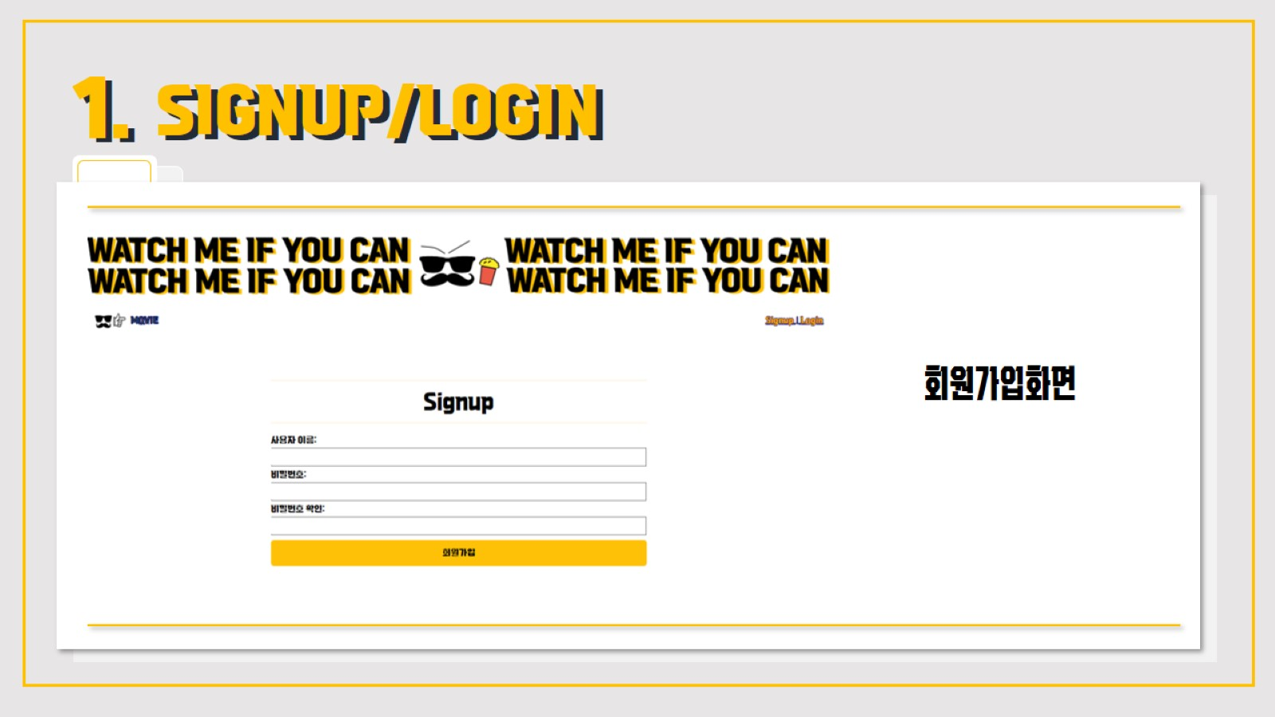
SIGNUP/LOGIN

Slide 5
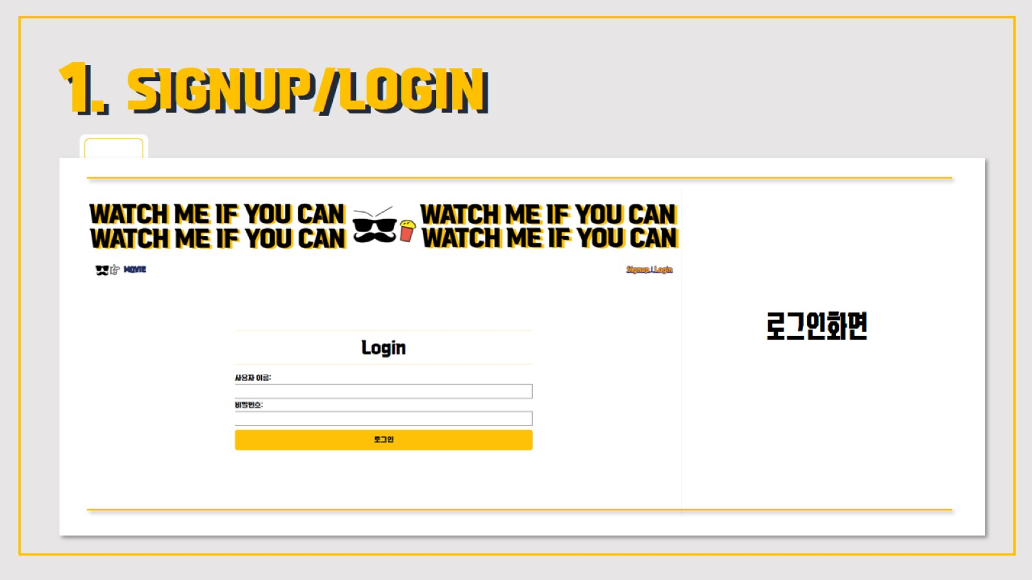

Slide 6

HOMEPAGE

Slide 7

MOVIEPAGE

Slide 8

MOVIEPAGE

Slide 9

MOVIEPAGE

Slide 10

MOVIEPAGE

Slide 11

MOVIEPAGE

Slide 12

MOVIEPAGE

Slide 13

LATESTMOVIEPAGE

Slide 14

COMMUNITY

Slide 15
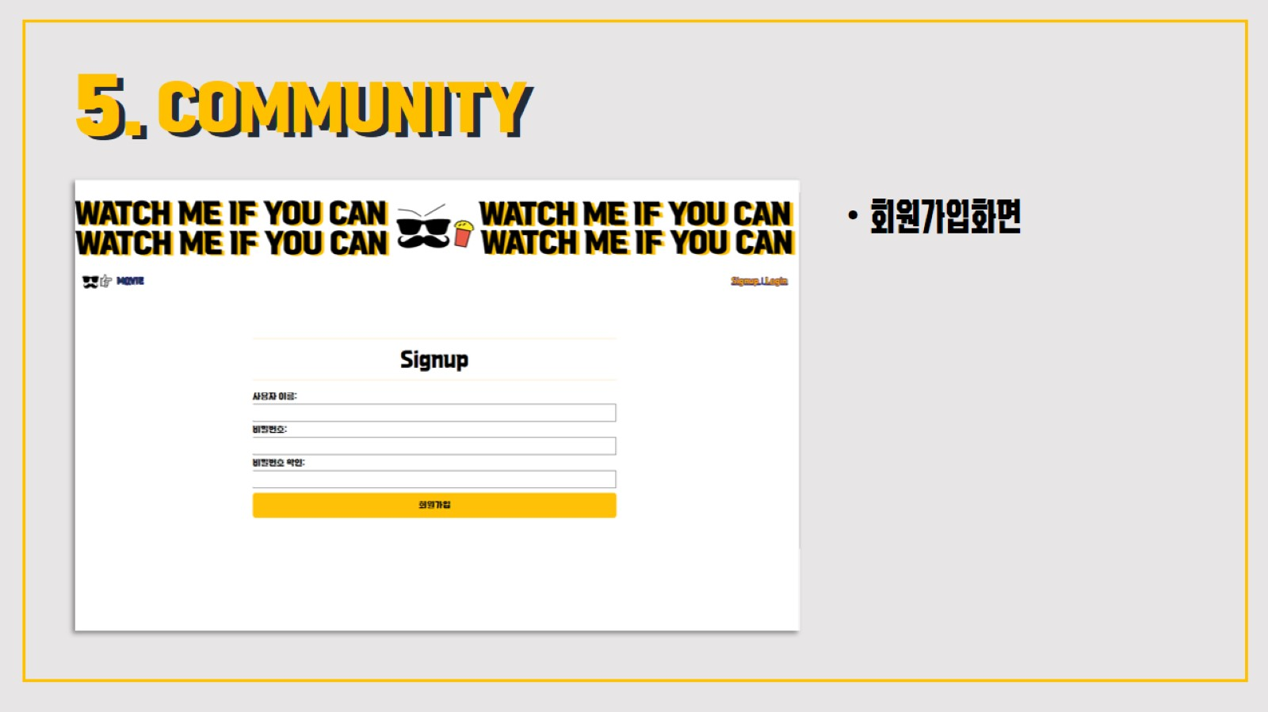
COMMUNITY

Slide 16

THANK YOU

